Slide 1


MATH630 Final Project: Hair cortisol levels, psychological stress and psychopathological symptoms as predictors of postpartum depression
DATE: Dec, 2018 PRESENTED BY: Nathaniel Evans, ALfonso Poire, Wei-Chun Lin

Slide 2
Summary of the paper
Importance:
Postpartum depression affects a huge number of women and has detrimental consequences.
Knowing the factors associated with postpartum depression during pregnancy can help its prevention.

Slide 3
Summary of the paper
Scientific question:
Does the socio-demographic, obstetric, and psychological variables along with hair cortisol levels during the first, second, and third trimesters of pregnancy be able to predict postpartum depression symptoms?

Slide 4
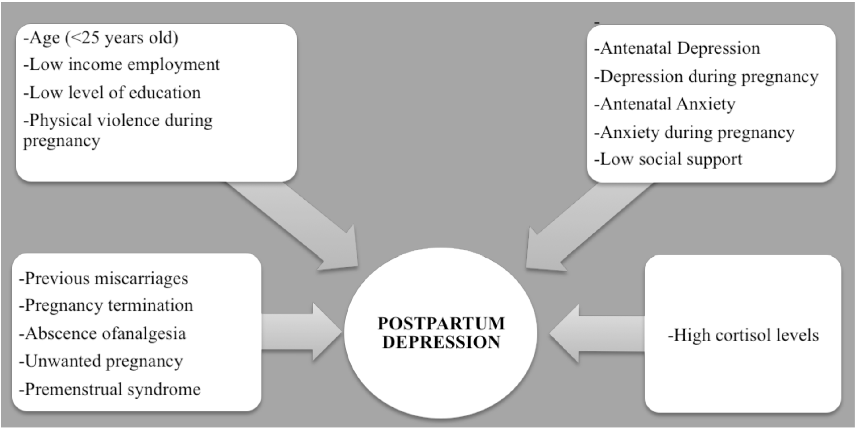
Summary of the paper
Summary of risk factors during pregnancy associated with postpartum depression

Slide 5
Summary of the paper
Environment: 3 health centers in the South of Spain
Sample size: 44 subjects
Postpartum depression group: 16 subjects
No postpartum depression group: 28 subjects

Slide 6
Summary of the paper
Biological measures (Hair cortisol levels)
Maternal perceived stress
Psychopathological symptoms
Pregnancy-specific stress
Measurement of postpartum depression

Slide 7
Analytical methods
2-sample t-tests and a chi-square test were used to compare socio- demographic, obstetric, and hair characteristics between groups.
ANOVA was conducted to check for statistically significant differences between both groups.
2-sample t-test was conducted to test whether the sex of the fetus could influence cortisol levels.
Multiple regression analyses to predict Edinburgh Postnatal Depression Scale scores (EPDS).

Slide 8
Issues of data quality review
Values are missing
Variable names are in Spanish
Some variable names are ambiguous
Questionnaires were conducted in different places.
Data were entered by humans

Slide 9
Issues of data quality review
Sample is not random
Margin-of-error is too large and unknown (psychology)
Seasonal variation skews the data (summer/winter)
Frame of reference has been manipulated

Slide 10
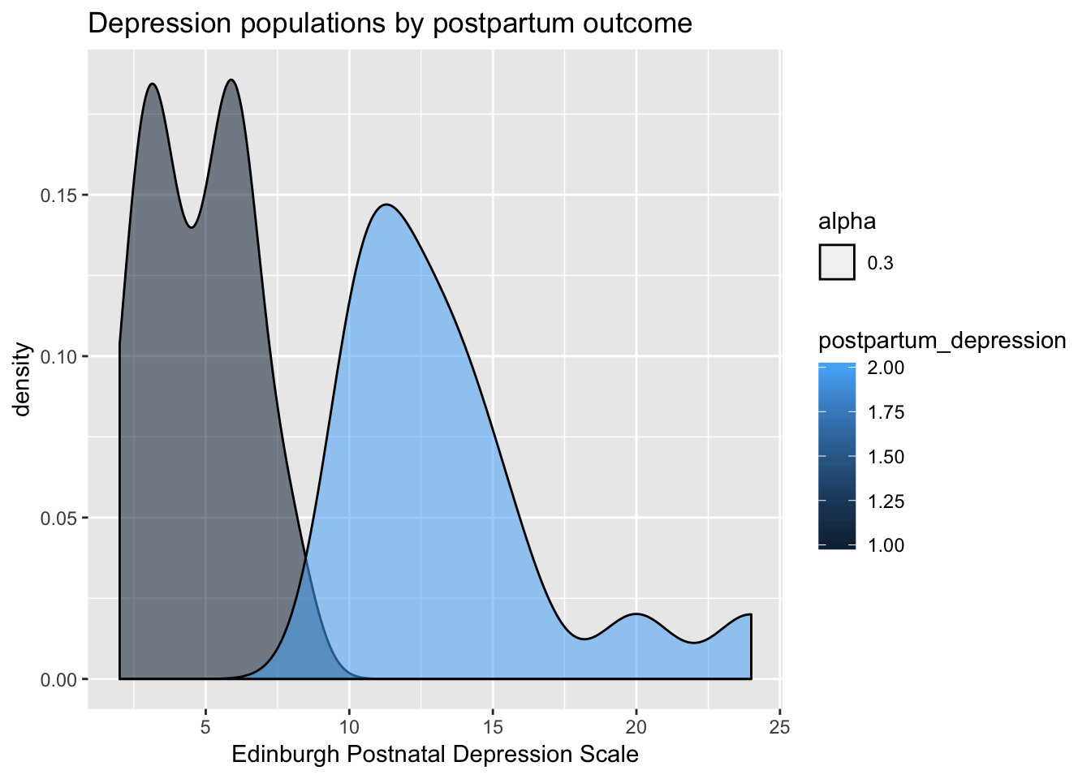
Exploratory data analysis
How does depression scores map to postpartum depression labels? Might there be a better threshold cutoff?

Slide 11
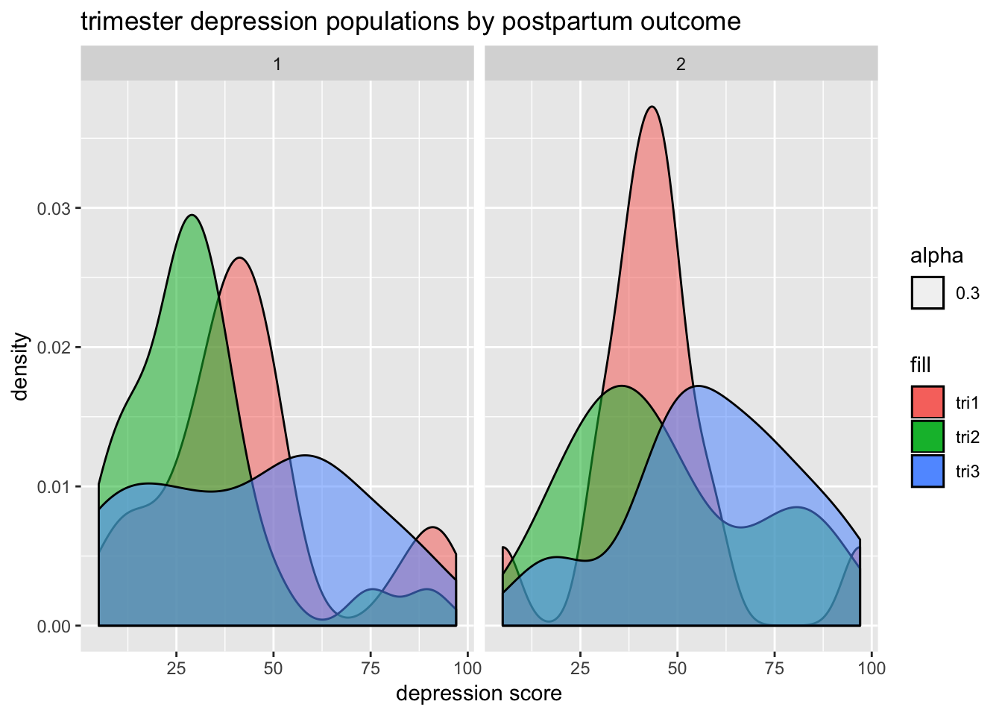
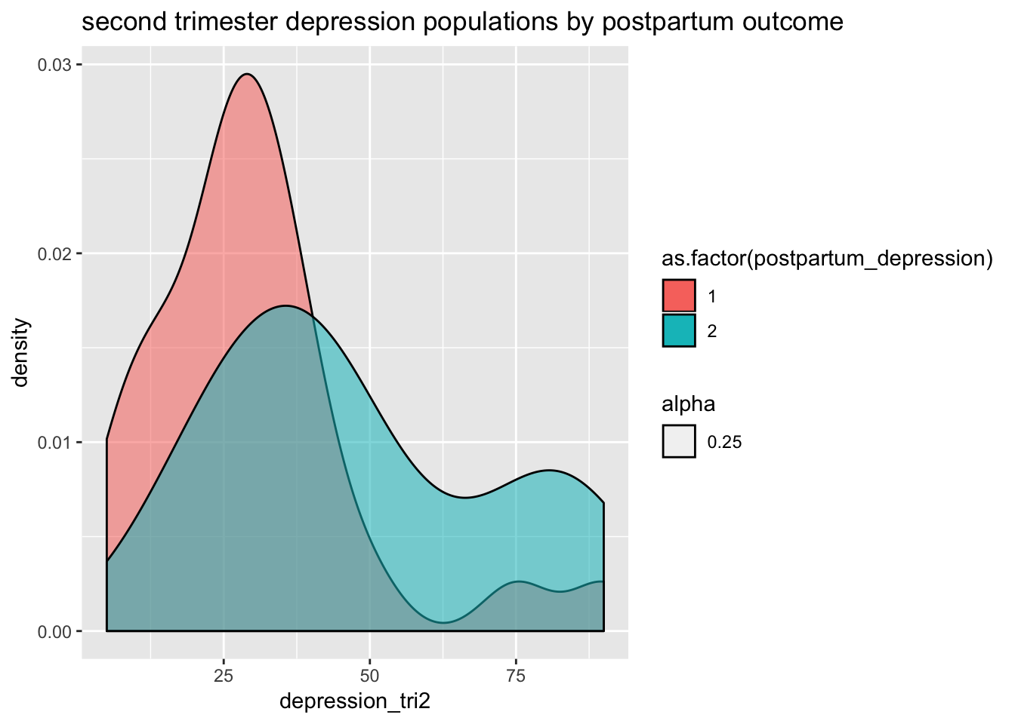
Exploratory data analysis
Relationships between the various trimesters and the levels of cortisol or the depression index score.

Slide 12
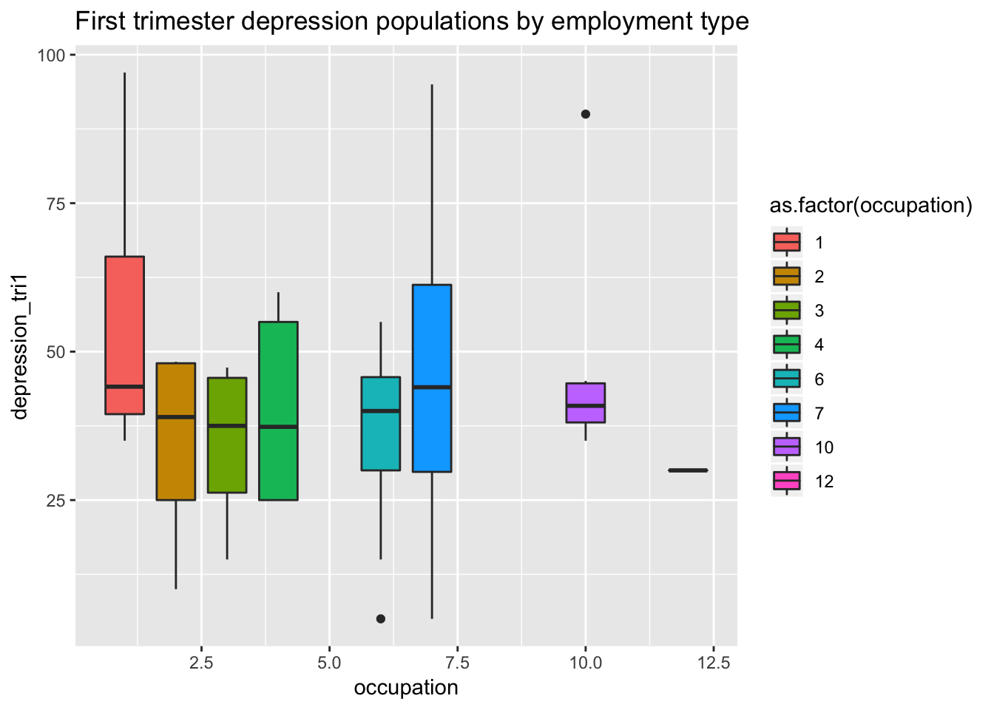
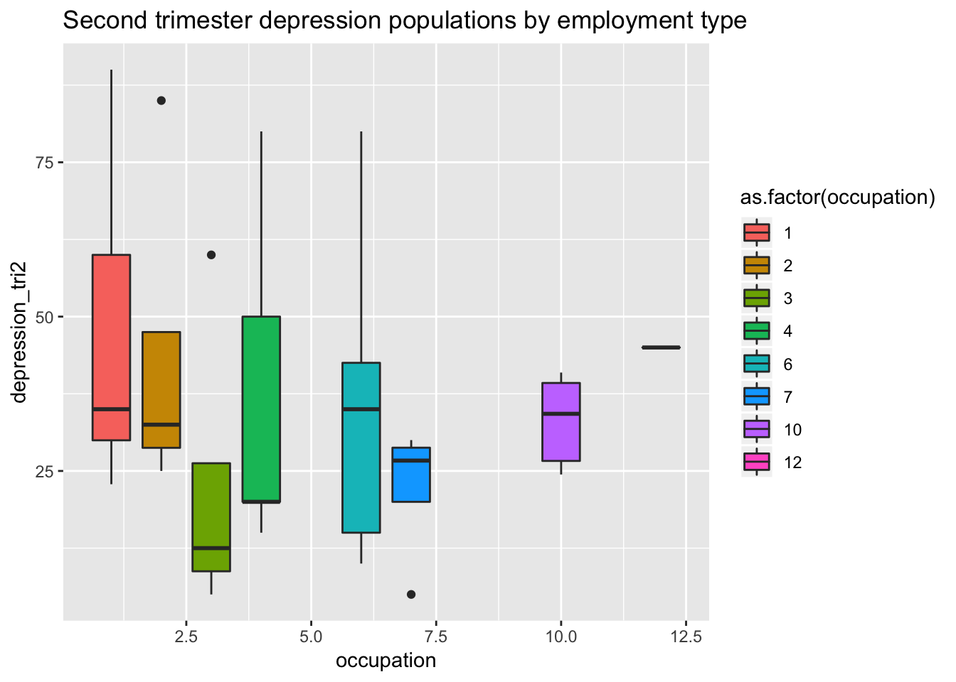
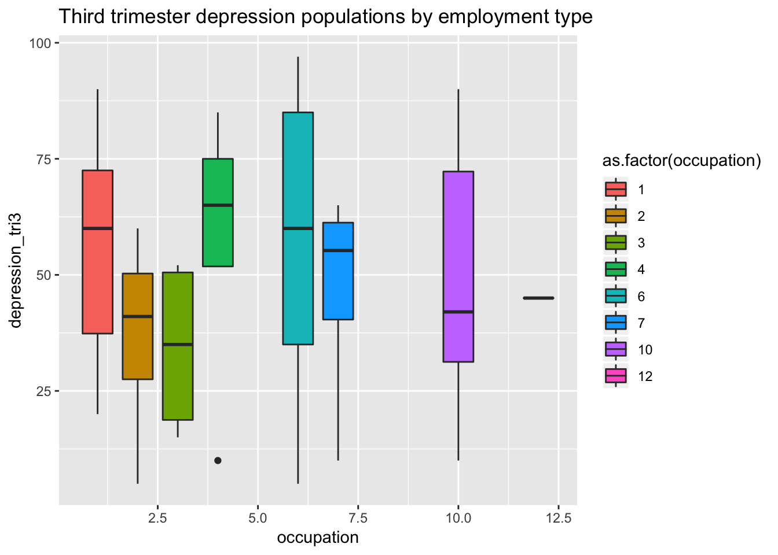
Exploratory data analysis
Relationship between job type and depression score and cortisol levels. - There does seem to be some correlation here between having a job and depression score but not so much cortisol levels. (1 = unemployment)

Slide 13
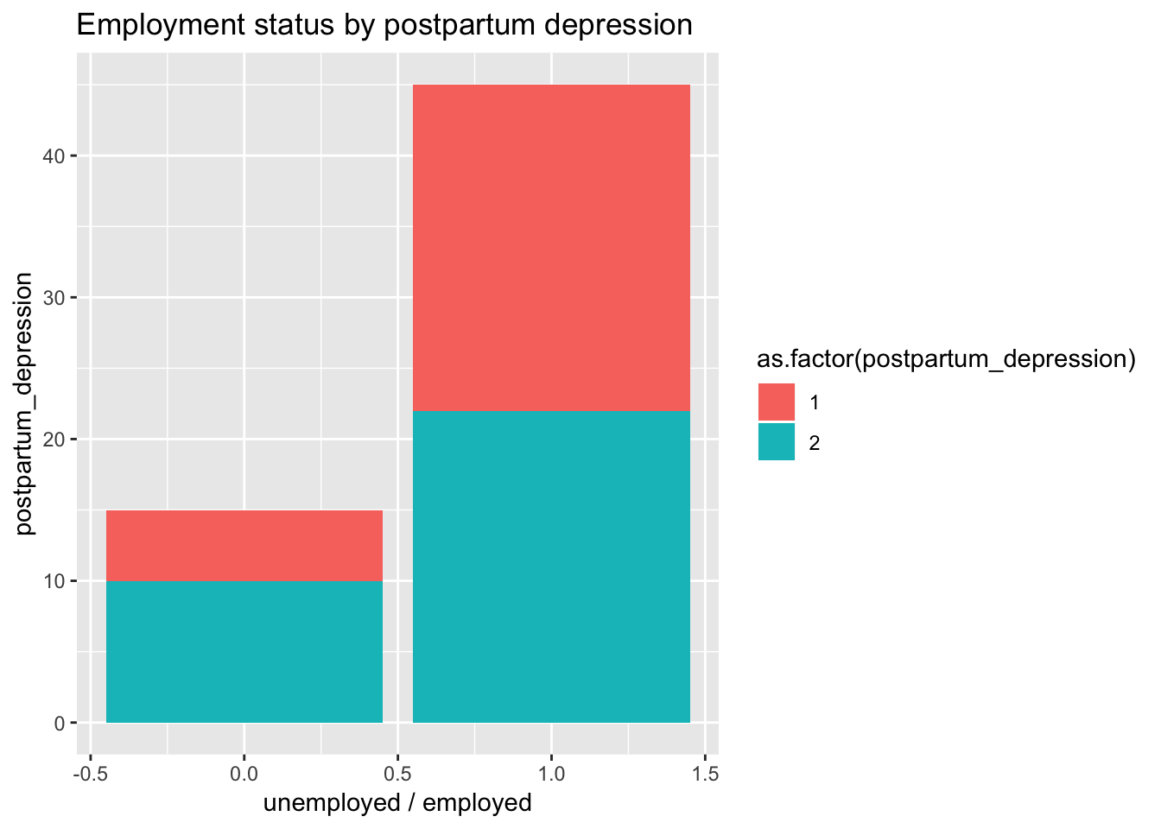
Exploratory data analysis
It seems that there could be some correlation between being employed and being less likely to be affected by postpartum depression however the sample size for employed women is vey small so this observation could normalize with a larger data set.

Slide 14
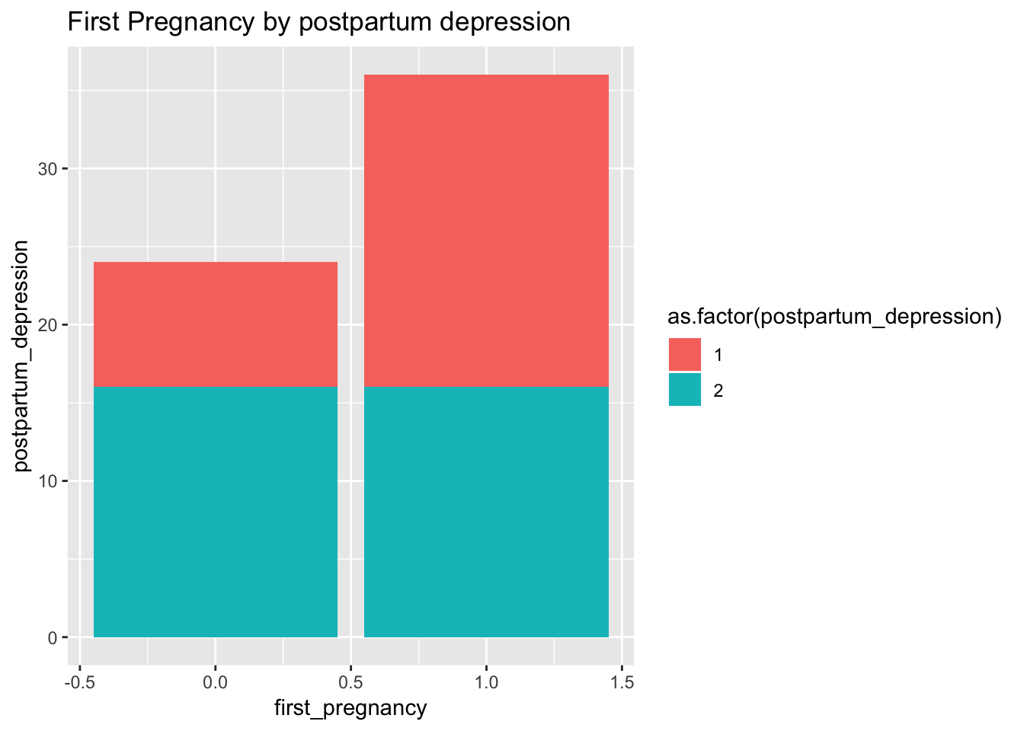
Exploratory data analysis
Women on their first pregnancy are more likely to be affected by postpartum depression however again this may be due to the sample size.

Slide 15
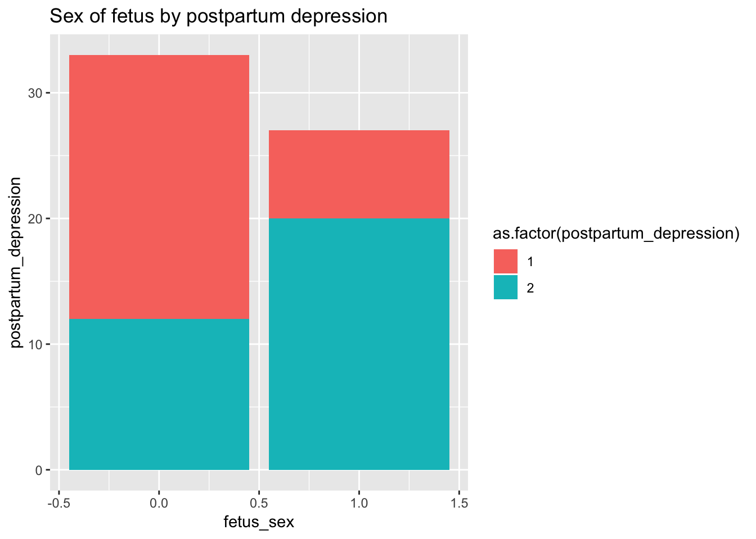
Exploratory data analysis
We investigated the affect of fetal sex on post partum depression and found the possible correlation between fetal sex and depression mentioned in the paper

Slide 16
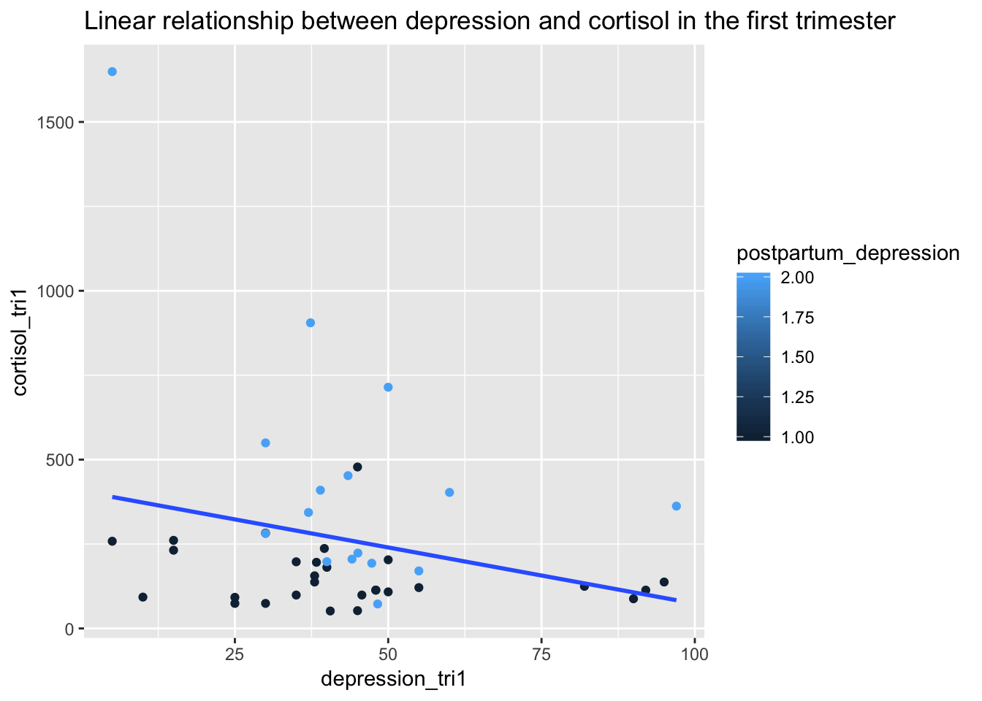
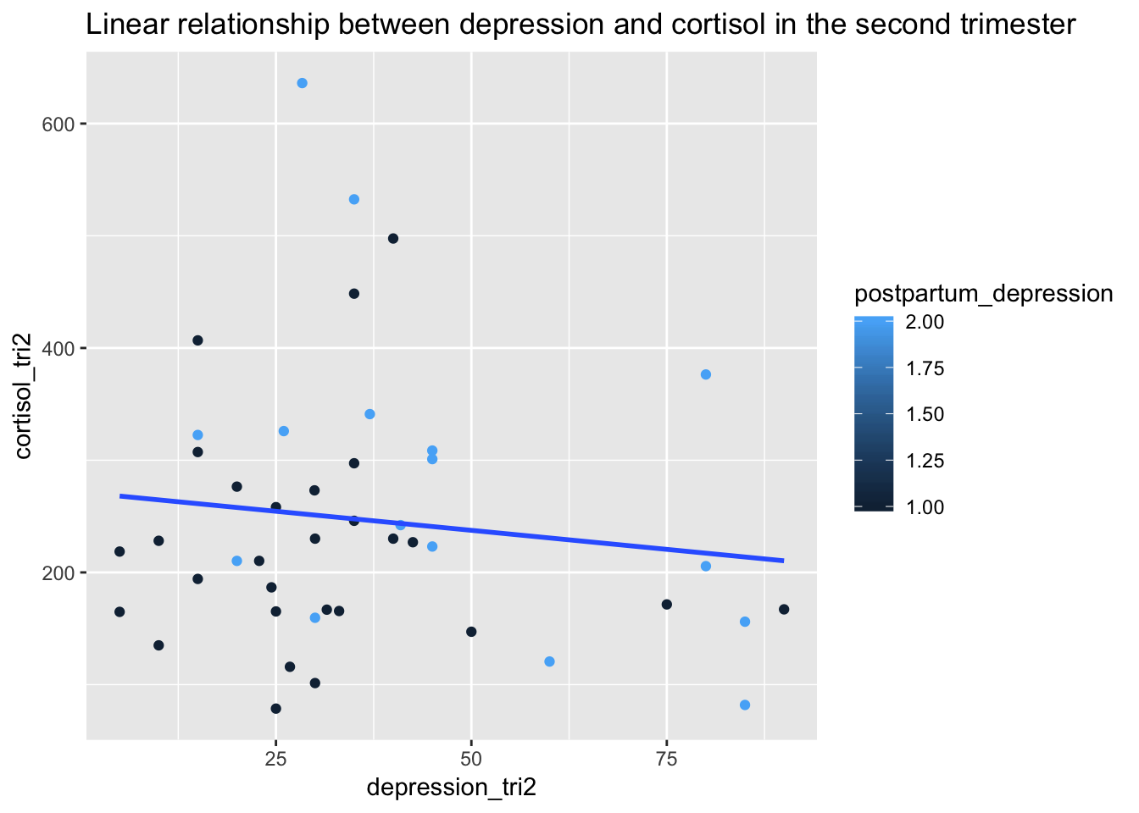
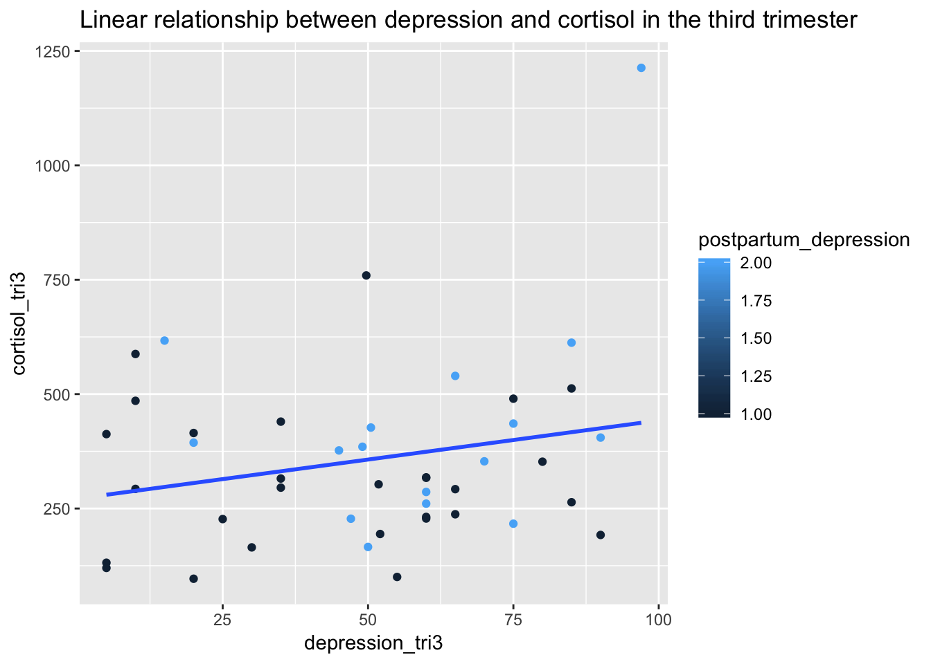
Exploratory data analysis
Cortisol, depression relation across trimesters? This is interesting because it switches to a positive correlation in the last semester. also there is not much difference it seems in the points and that the regression line is being pulled by several outliers.

Slide 17
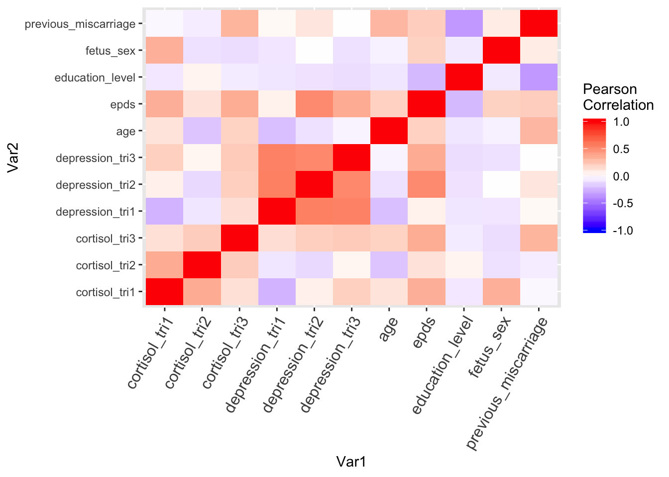
Exploratory data analysis
Do we have collinearity between variables? What do we want to avoid including in our model? There is significant collinearity between the biological and psychological metrics, which makes our validity for biological factors as a causal effect of postparatum depression.

Slide 18
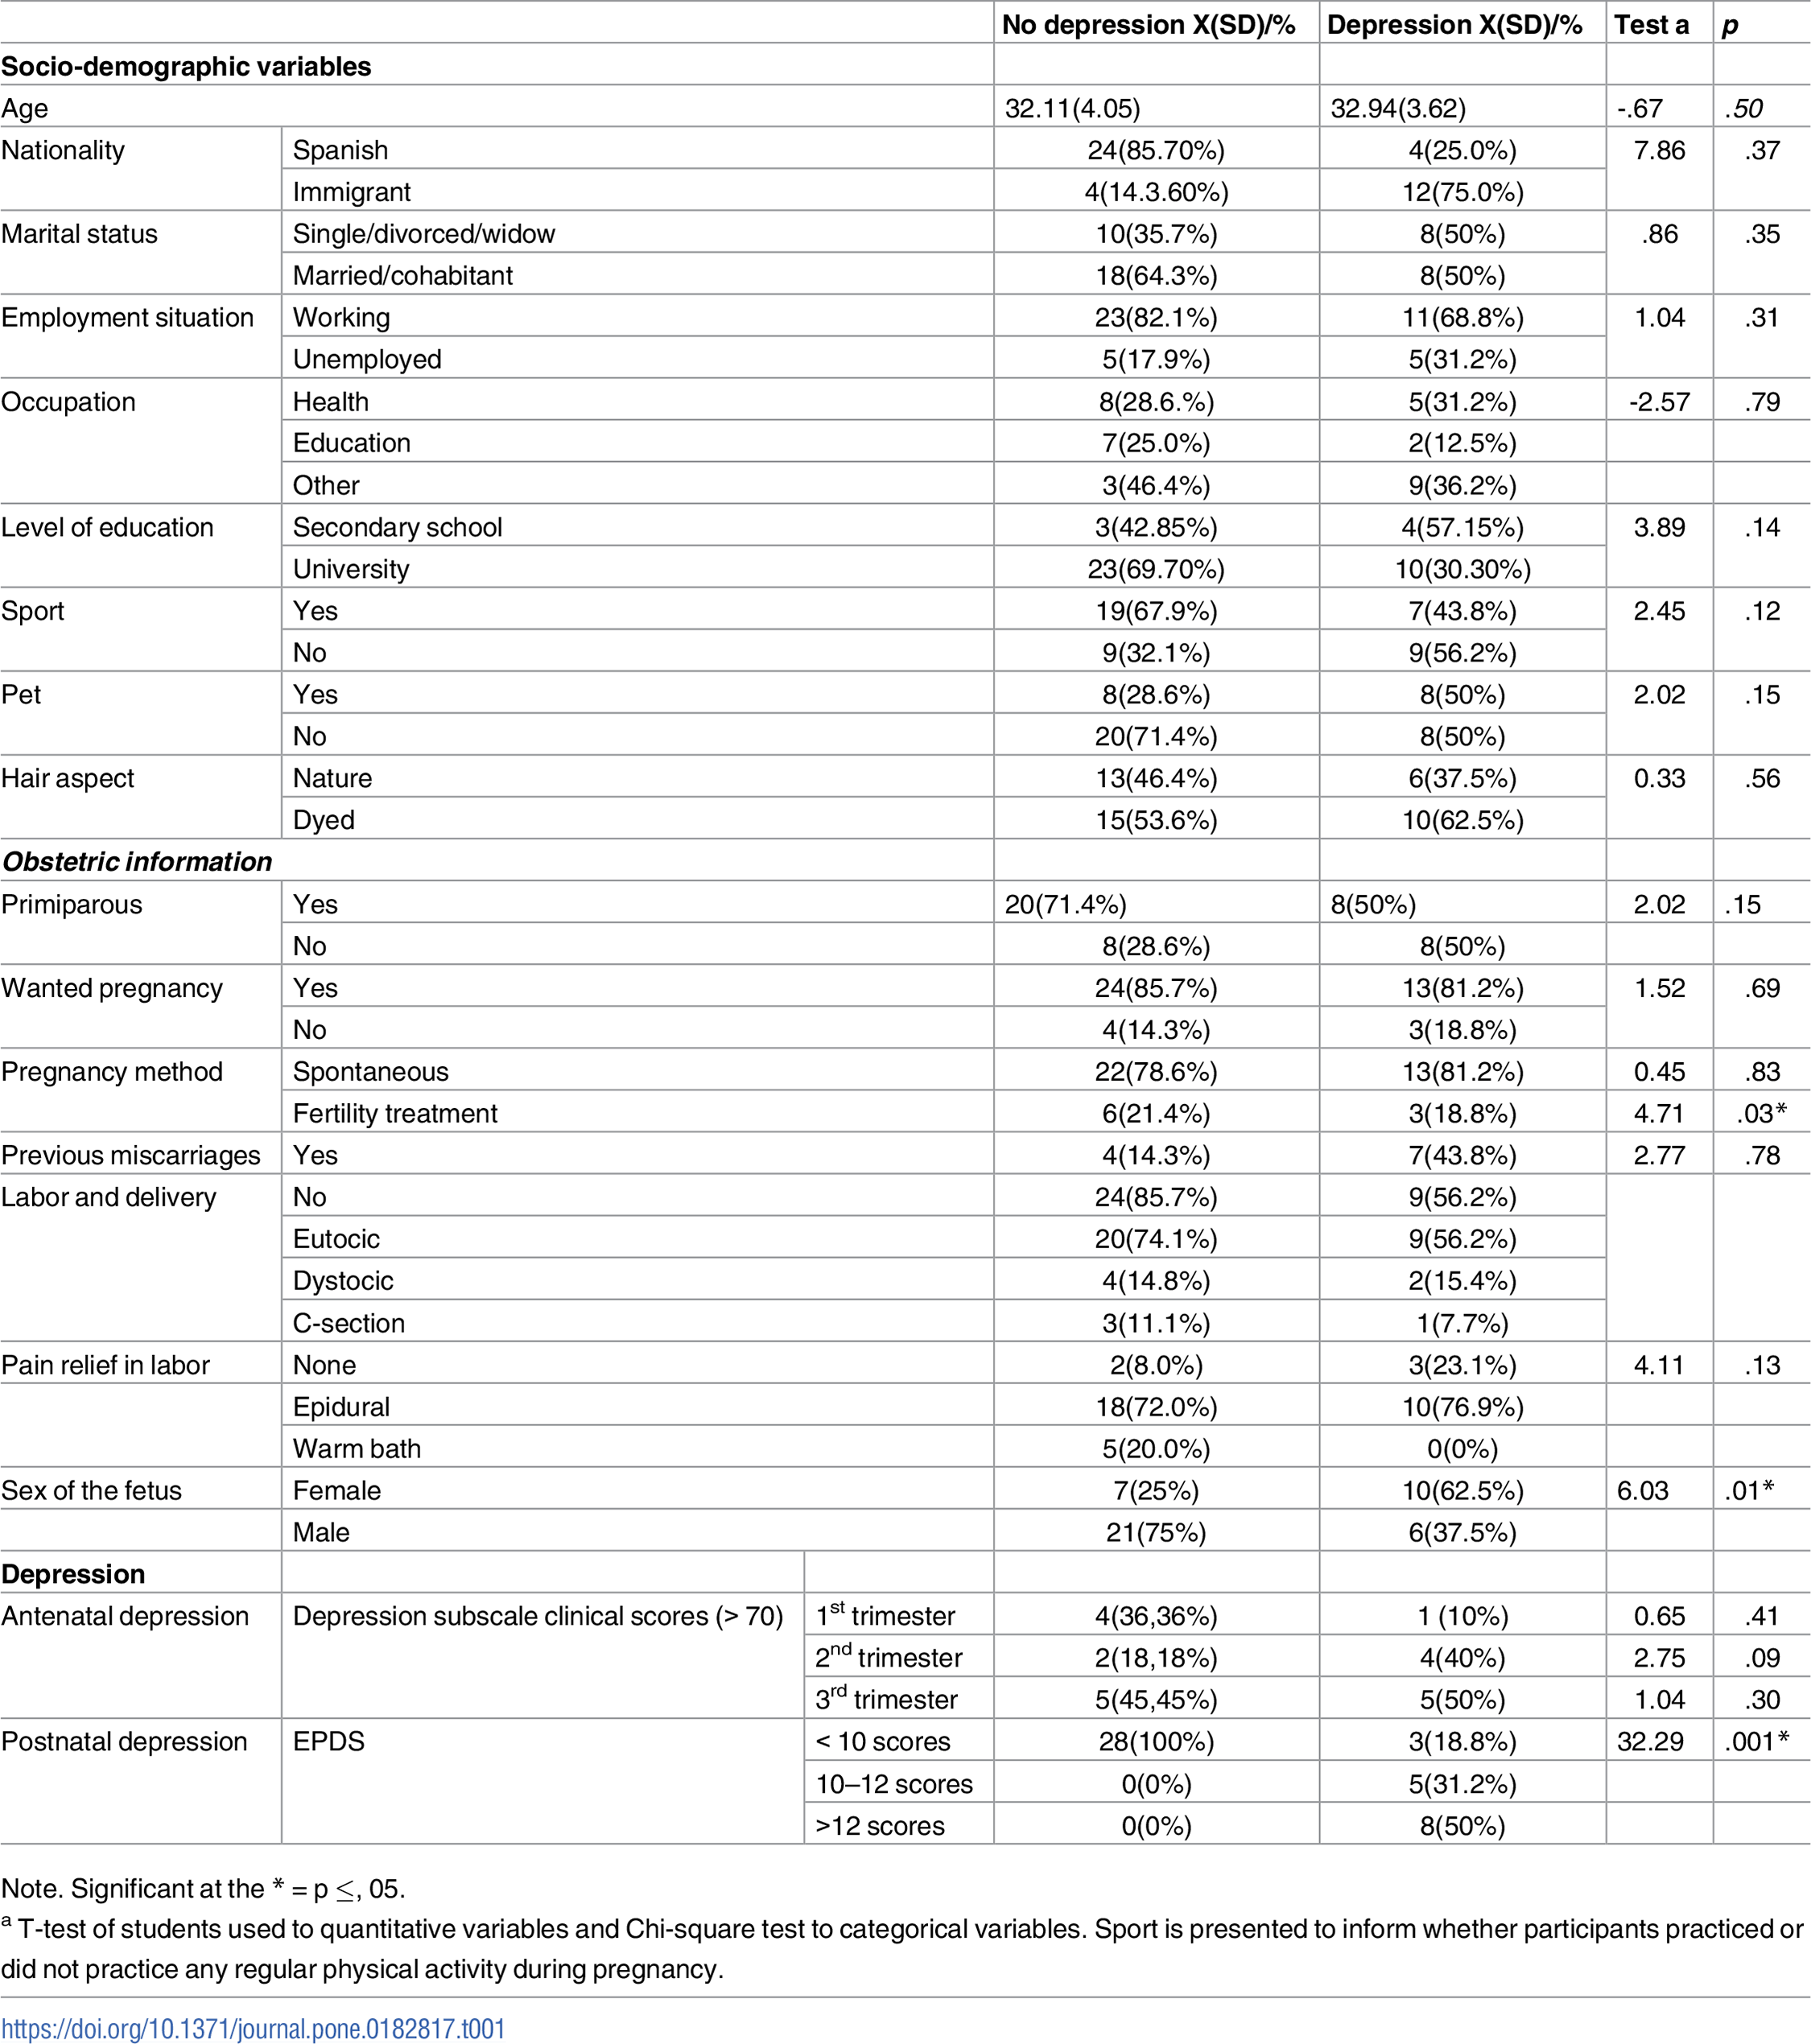
Replications – Table 1

Slide 19
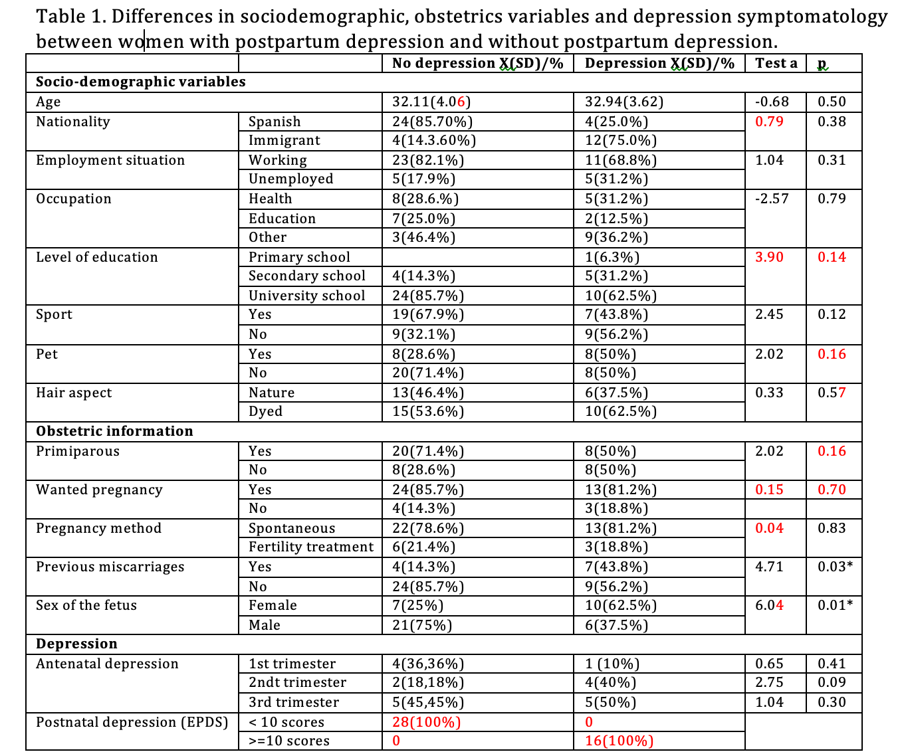

Slide 20
Replications – Table 1
Missing data - Marital status, Labor and delivery, Pain relief in labor
Errors in original table: Label in red
EPDS group was wrong in original table
Interaction effect

Slide 21
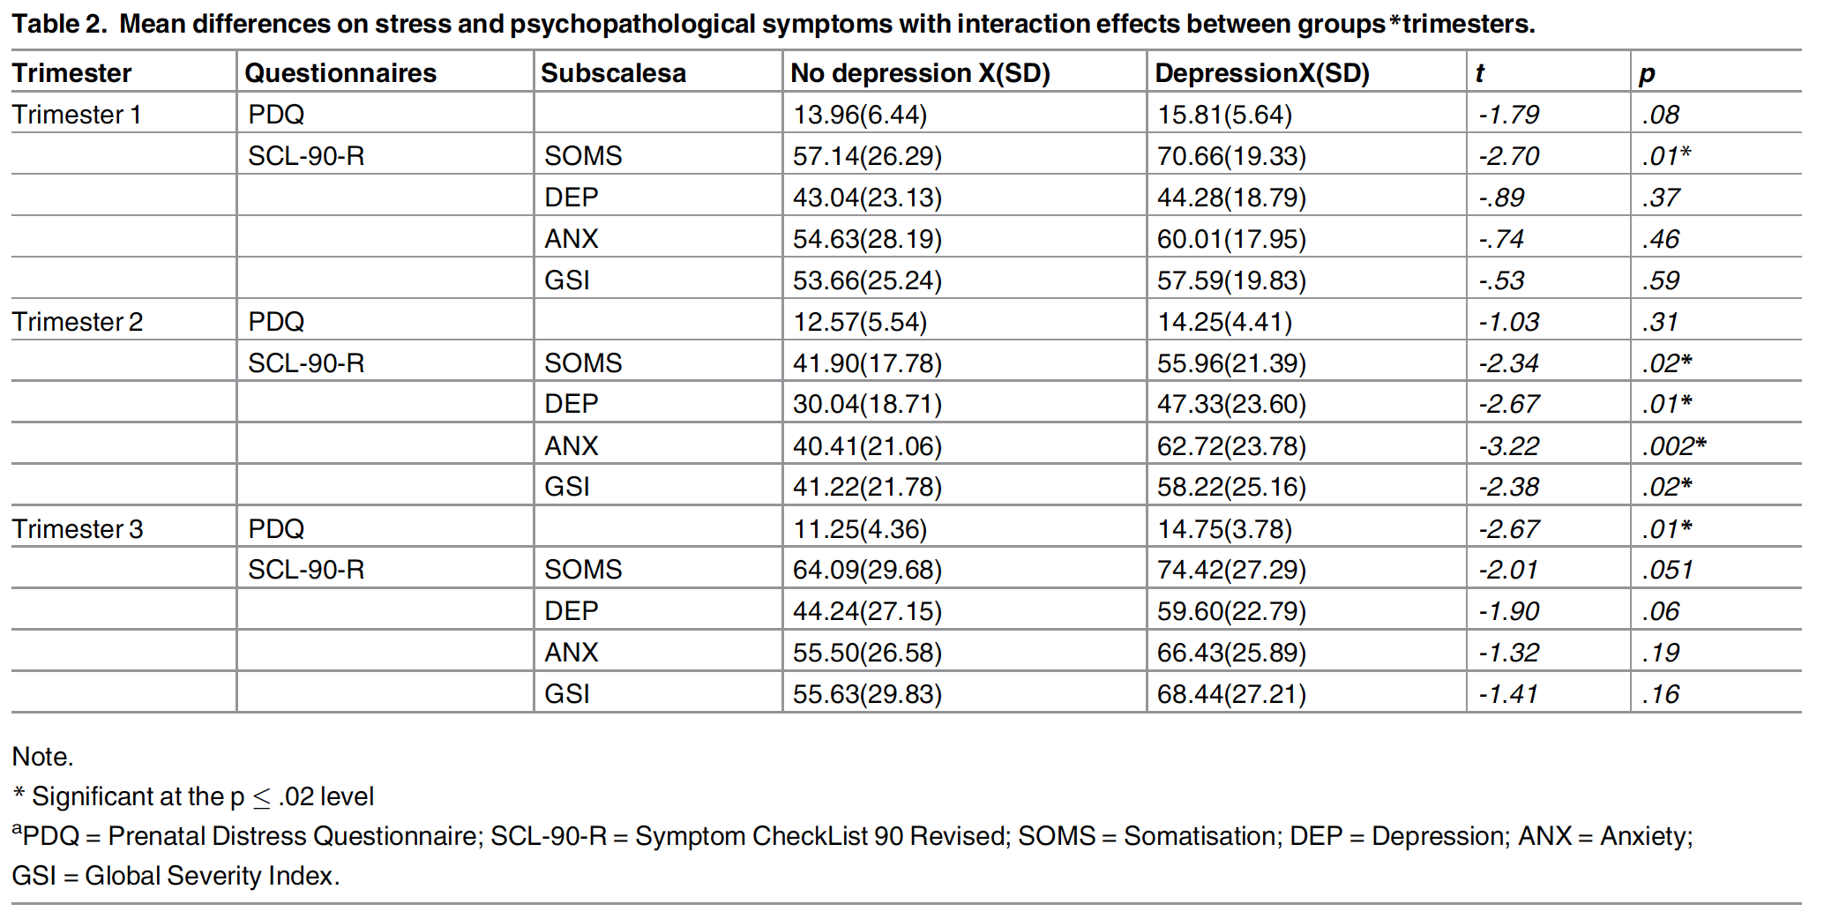
Replications – Table 2

Slide 22
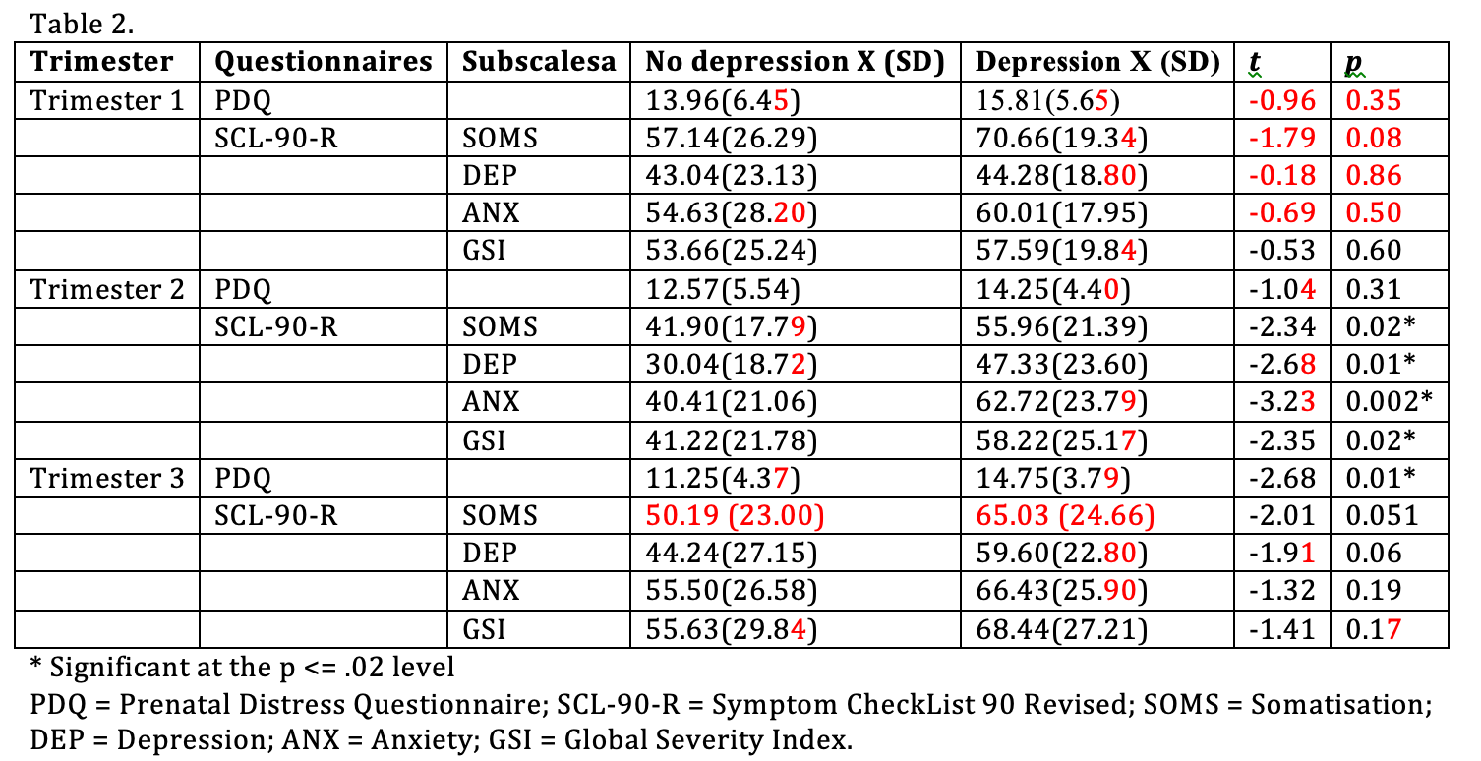

Slide 23
Replications – Table 2
Several errors label in red
Significant at the p-value as 0.02 level
Scales showing significant interaction effect group*trimester mean differences on psychopathological symptoms
Significant differences between both groups were found during the second trimester regarding the four subscale
No significant differences were found between both groups during the third trimester.

Slide 24
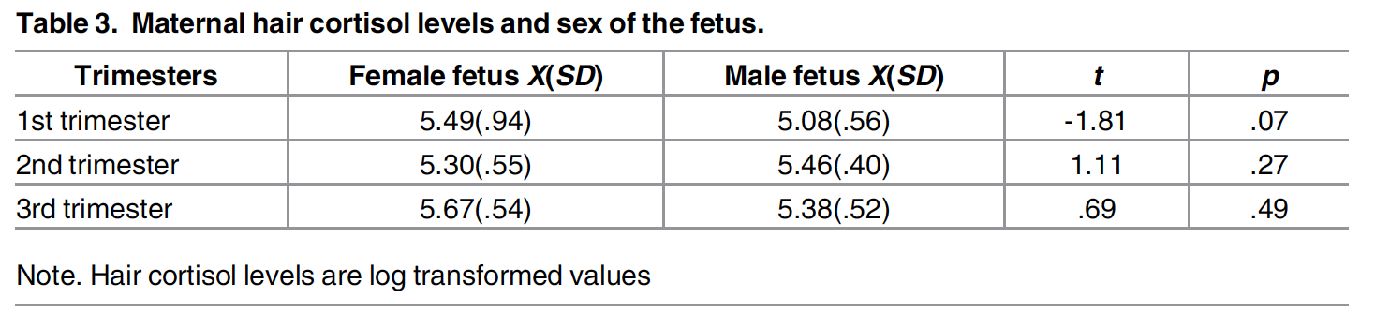
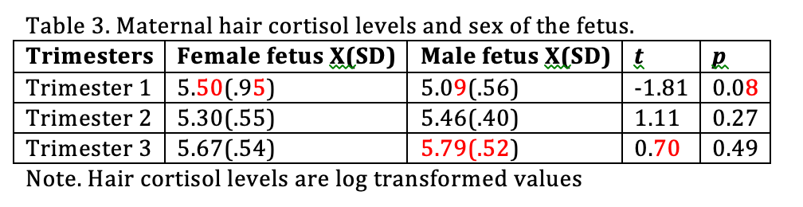
Replications – Table 3

Slide 25
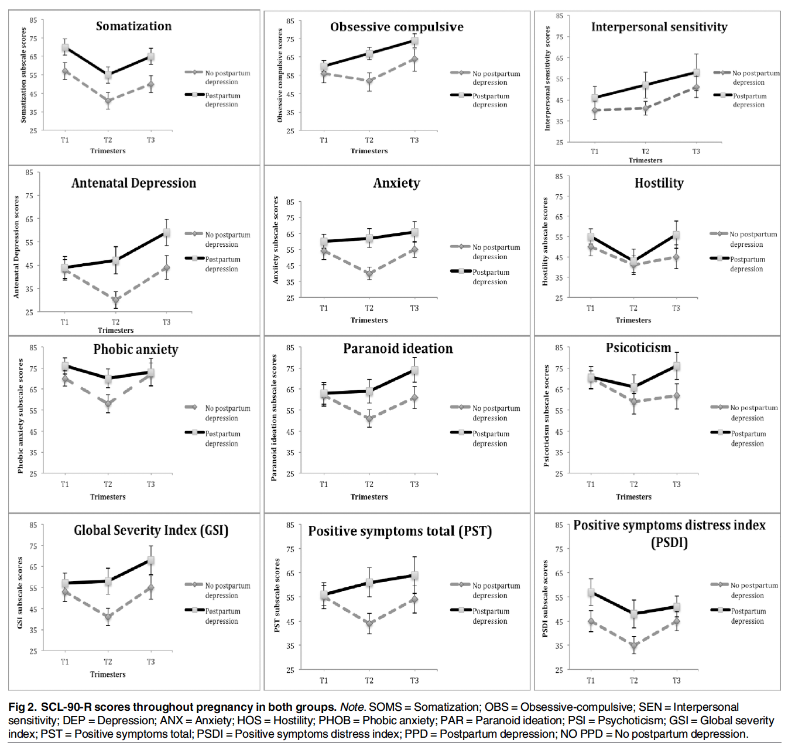
Replications – Figure 2

Slide 26
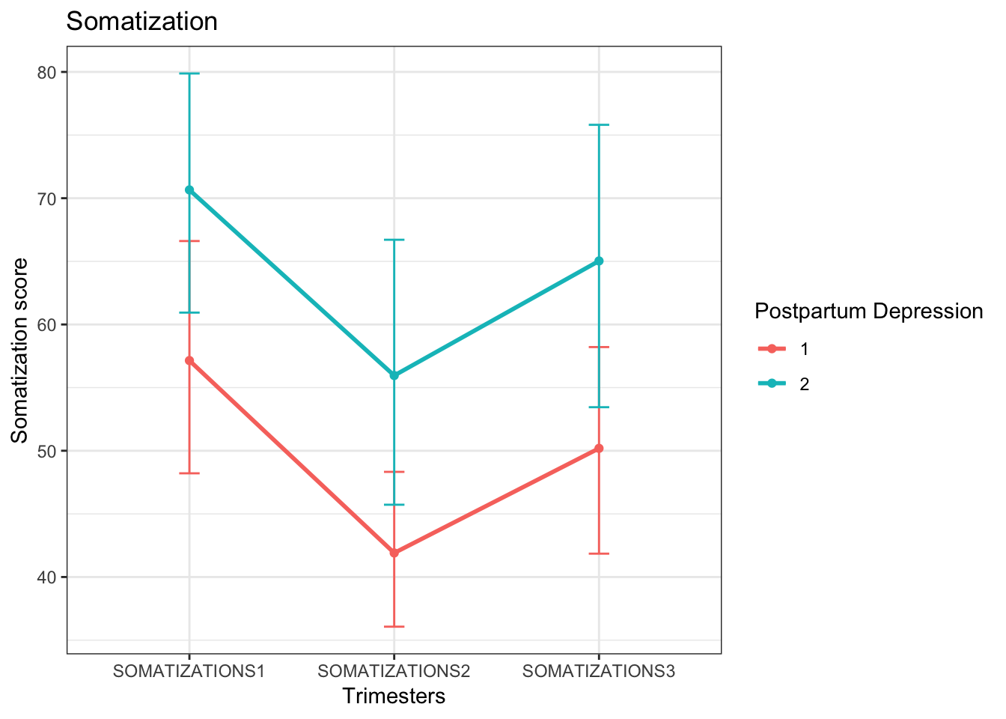
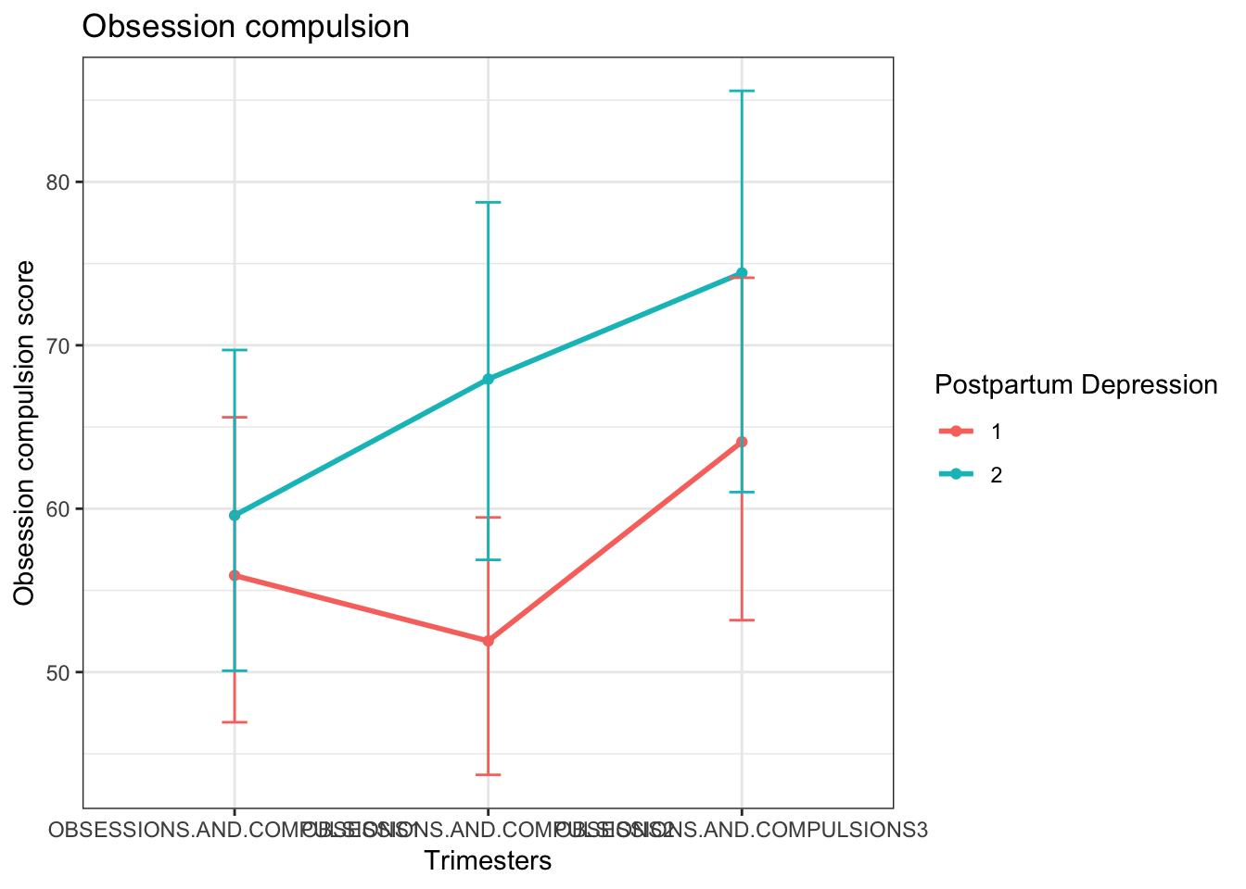
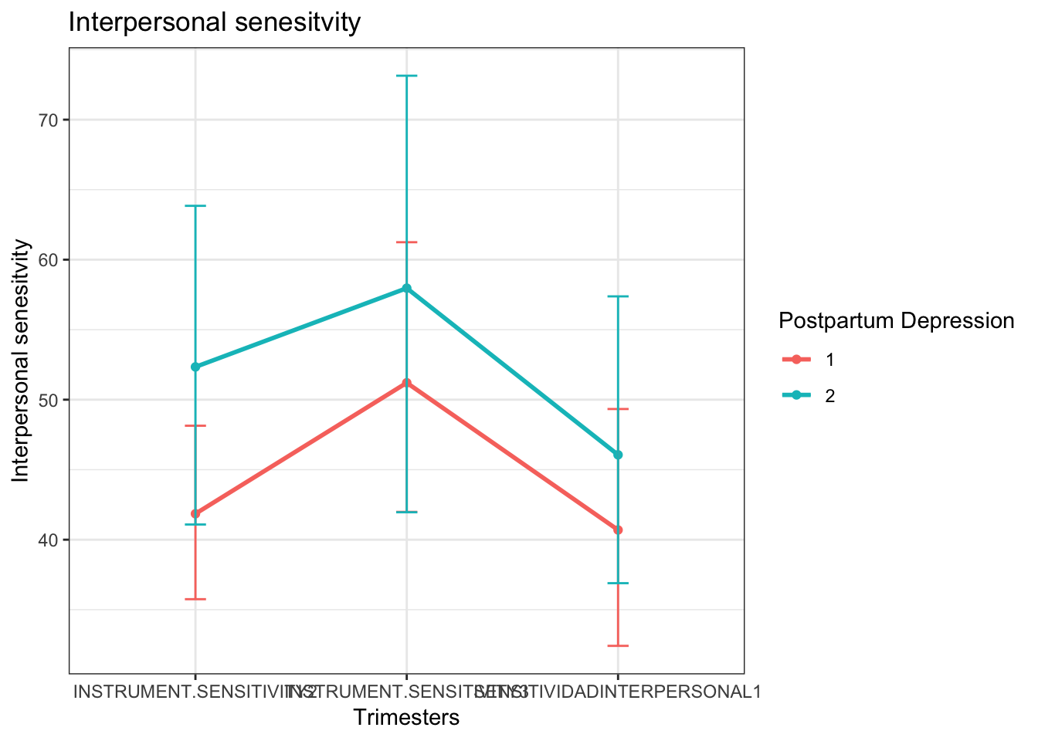
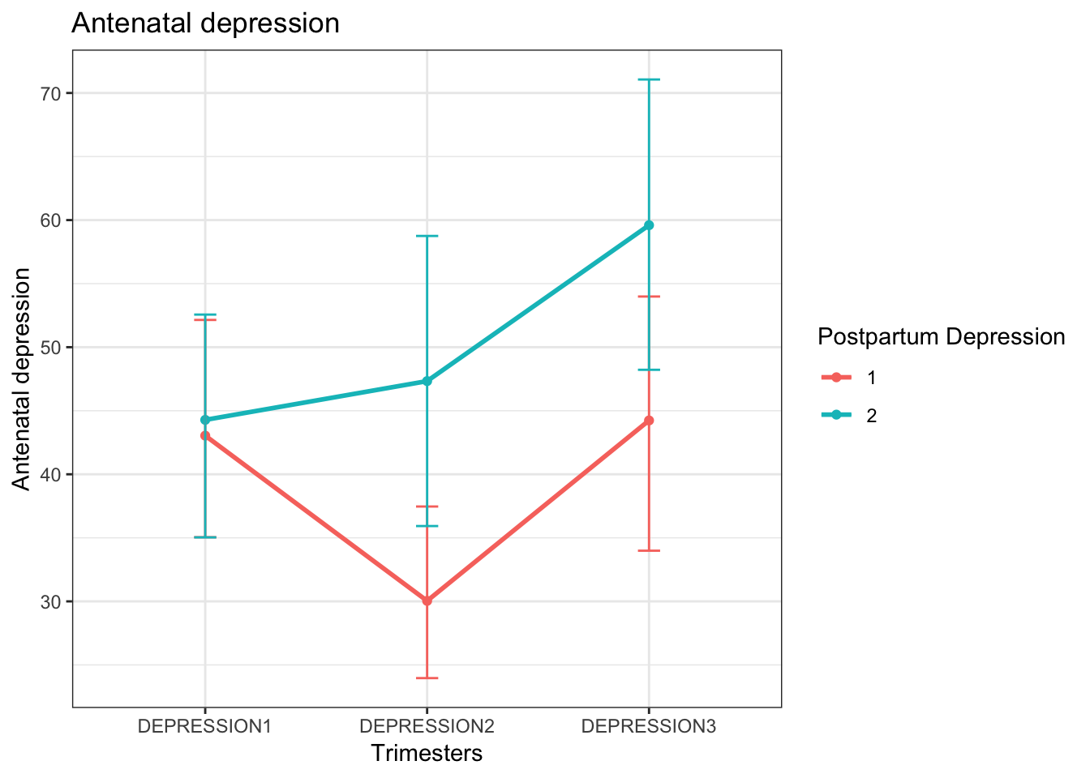
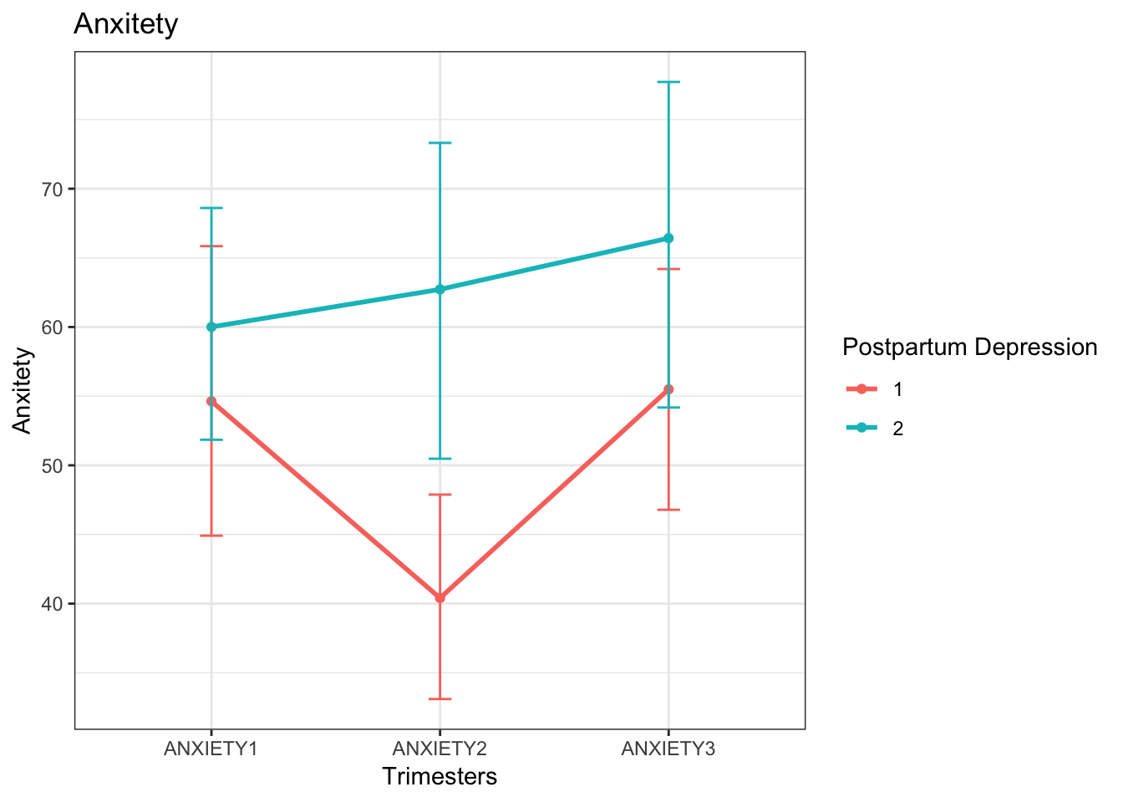
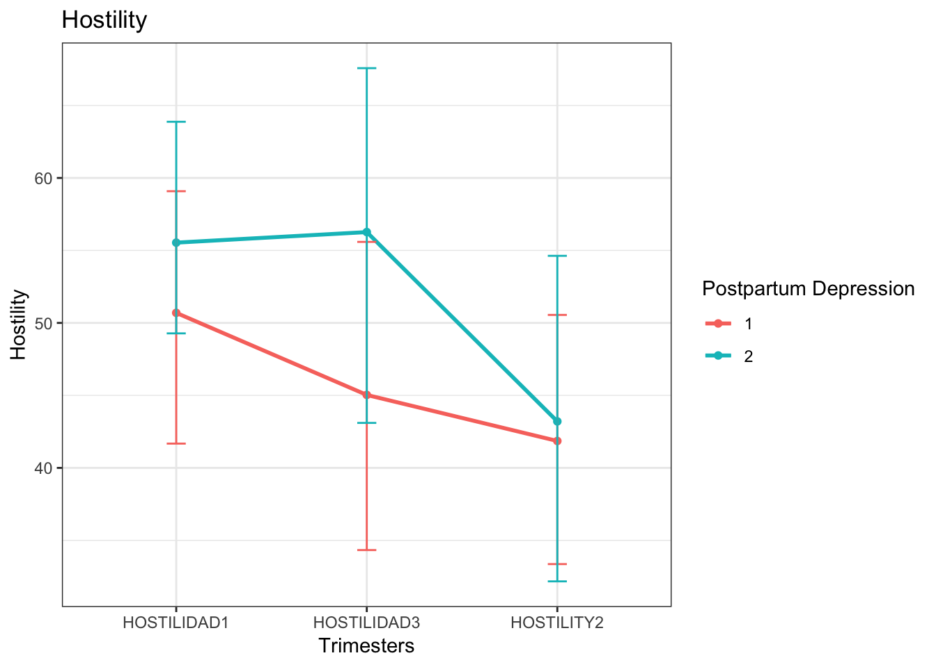
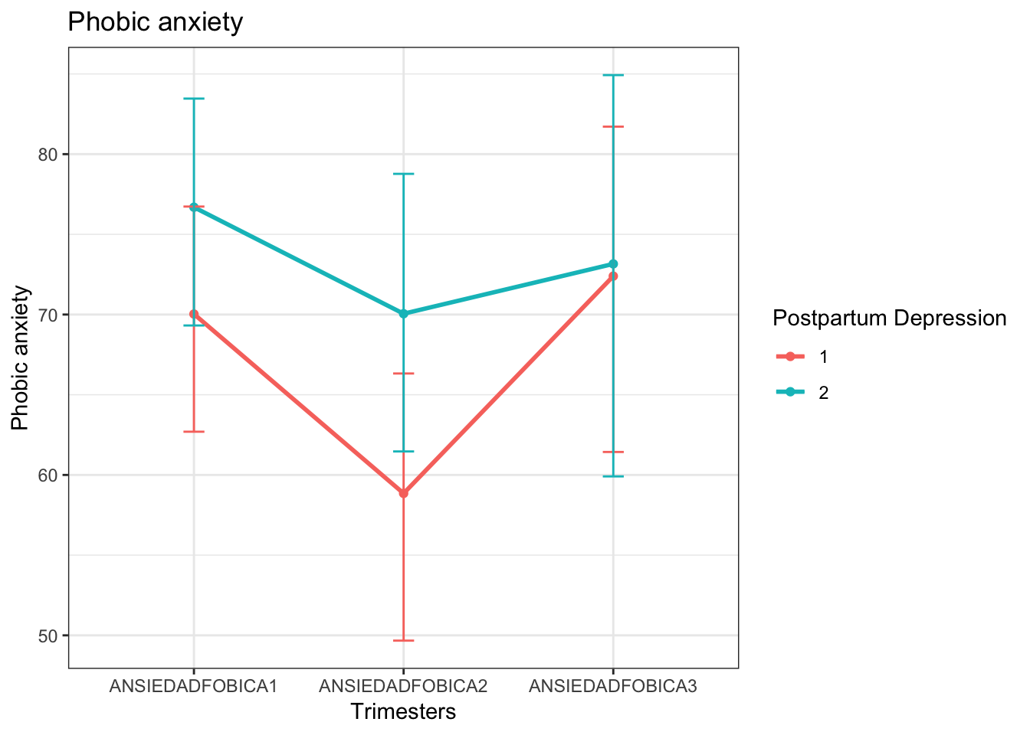
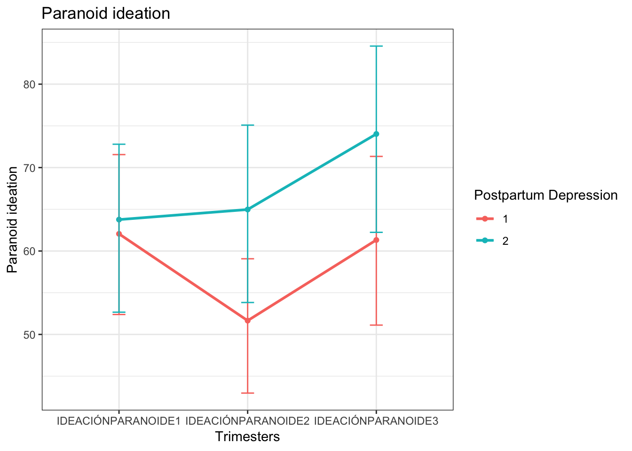
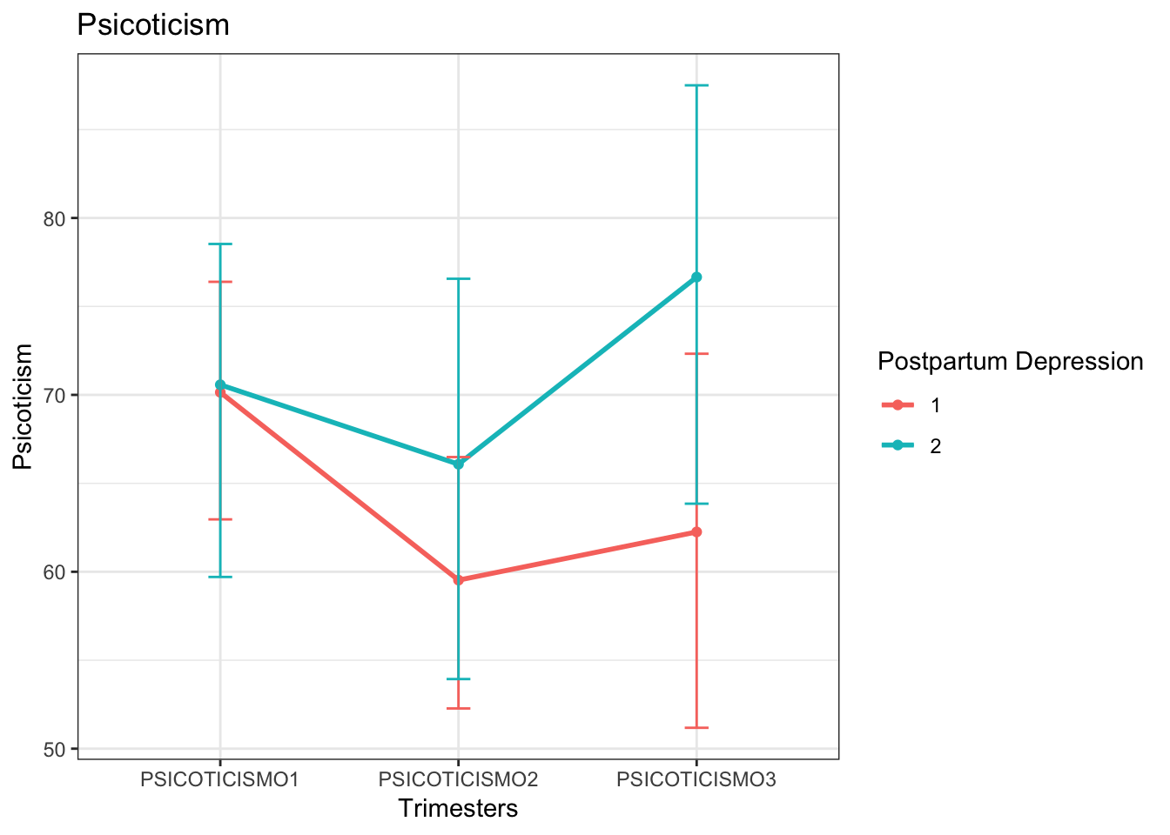
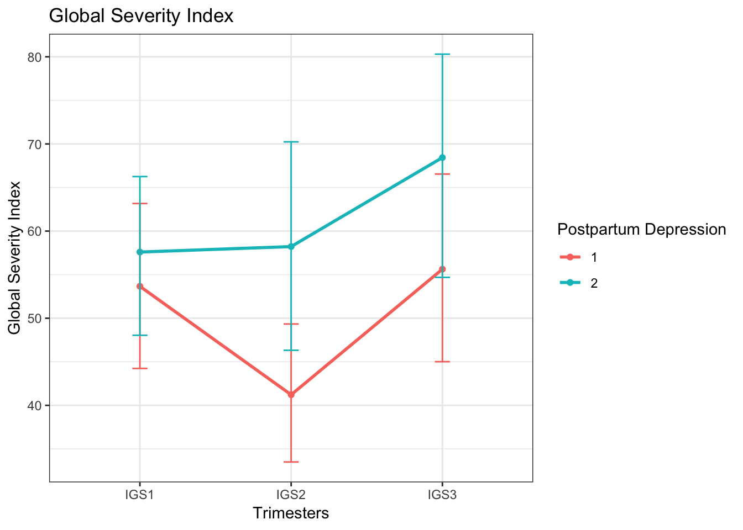
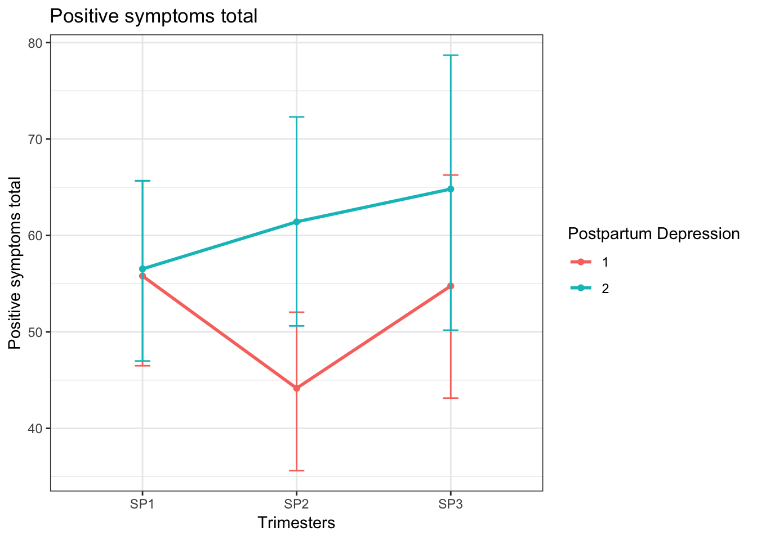
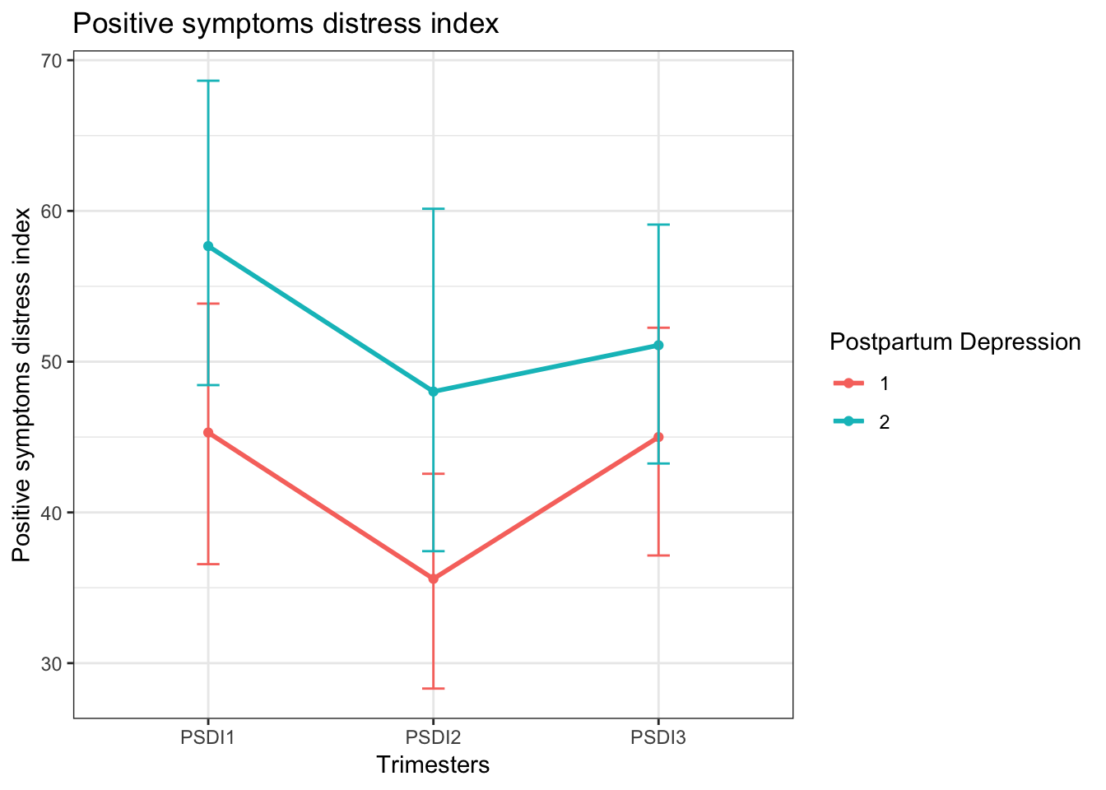

Slide 27
Replications – Figure 2
Difference – Interpersonal sensitivity and Hostility
Regarding psychopathological symptoms, the group with postpartum depression symptoms scored higher in every single SCL-90-R subscales during the first, second, and third trimester of pregnancy

Slide 28
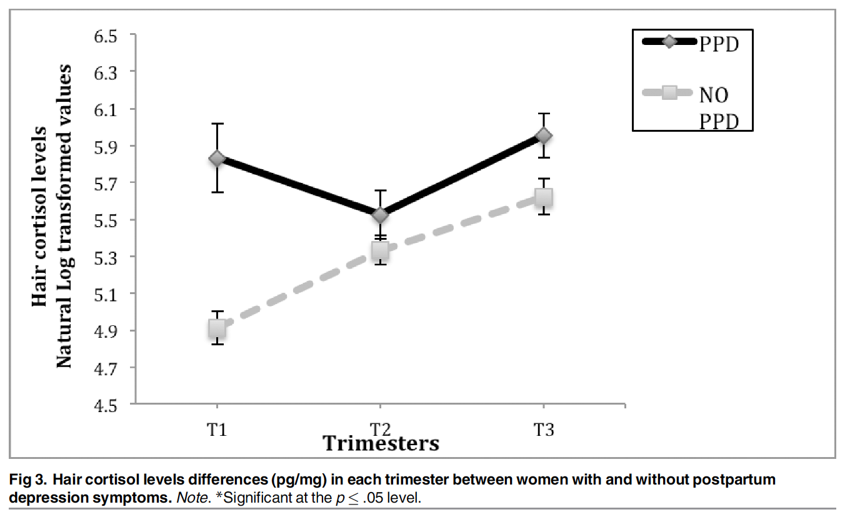
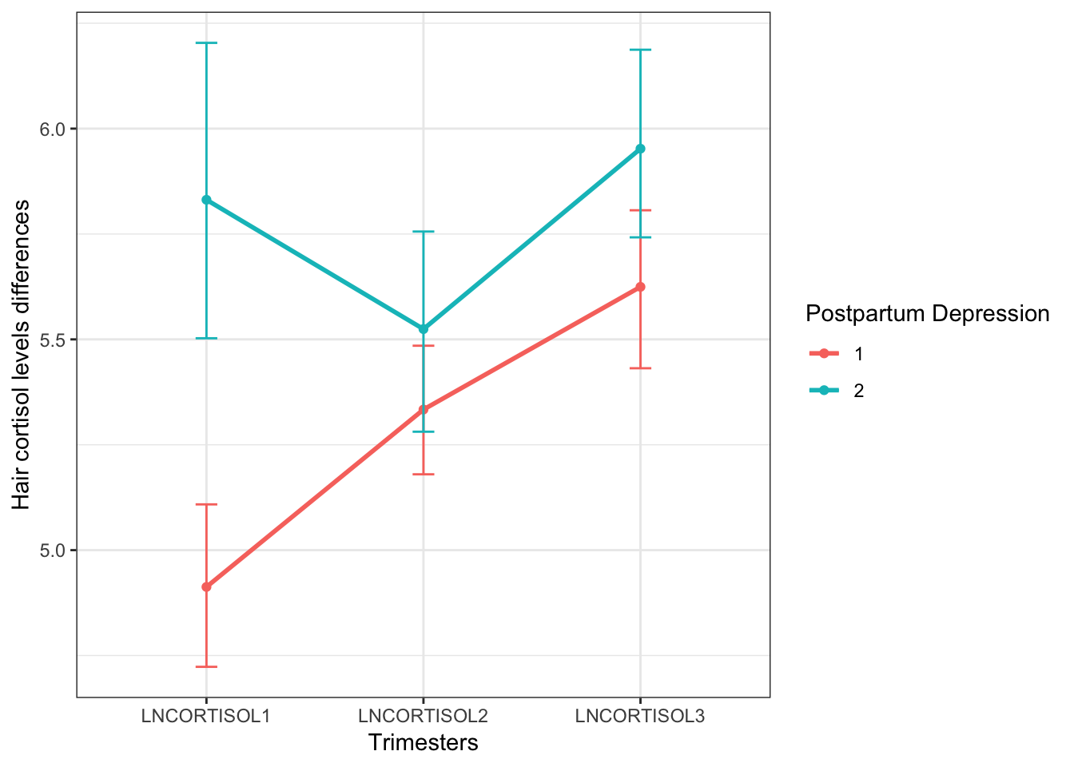
Replications – Figure 3

Slide 29
Replications – Figure 3
A 2 sample t-test revealed significant differences between groups regarding hair cortisol levels in the first trimester (t = -4.77; p-value < 0.001) and the third trimester (t = -2.06; p-value 0 .045).
No significant differences were found between groups in the second trimester

Slide 30
Multiple linear regression
Results of the regression revealed that hair cortisol levels could predict 21.7% of the variance of postpartum depression symptoms [R² = .21, (F = 3.711, p < .05)].
More precisely, hair cortisol at the first trimester (= 0.03, p < .05) and the third trimester ( = 0.03, p < .05) significantly predicted EPDS

Slide 31
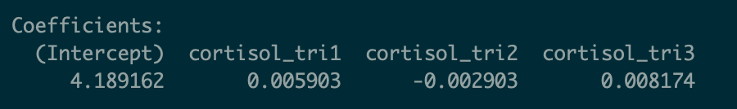
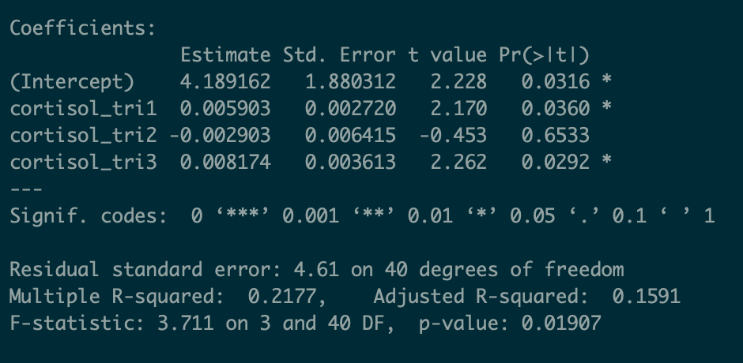
Multiple linear regression

Slide 32
Extension project and insights – Q1
Our question 1:
Can we get better model by using socio-demographic, obstetric, psychological, and hair cortisol levels during the first and third trimesters of pregnancy to predict postpartum depression symptoms?
Based on our EDA, we will use hair cortisol in 1st & 3rd trimester, antenatal depression, employment situation, first pregnancy, and sex of the fetus to develop the prediction model.

Slide 33
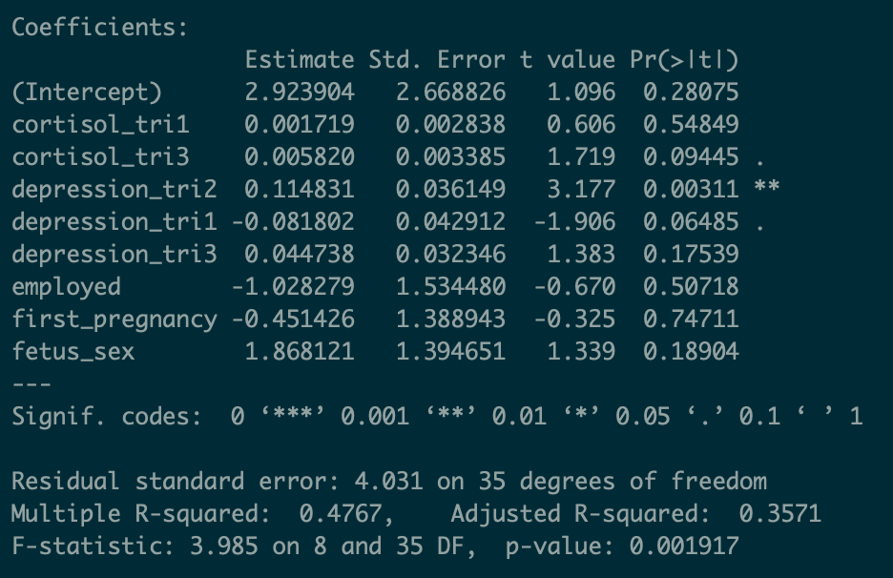
Extension project and insights – Q1

Slide 34
Extension project and insights – Q1
Results of the regression revealed that the model could predict 47.7% of the variance of postpartum depression symptoms [R² = 0.48, (F = 3.99, p < 0.001)].
Antenatal depression in trimester 2 significantly predicted EPDS

Slide 35
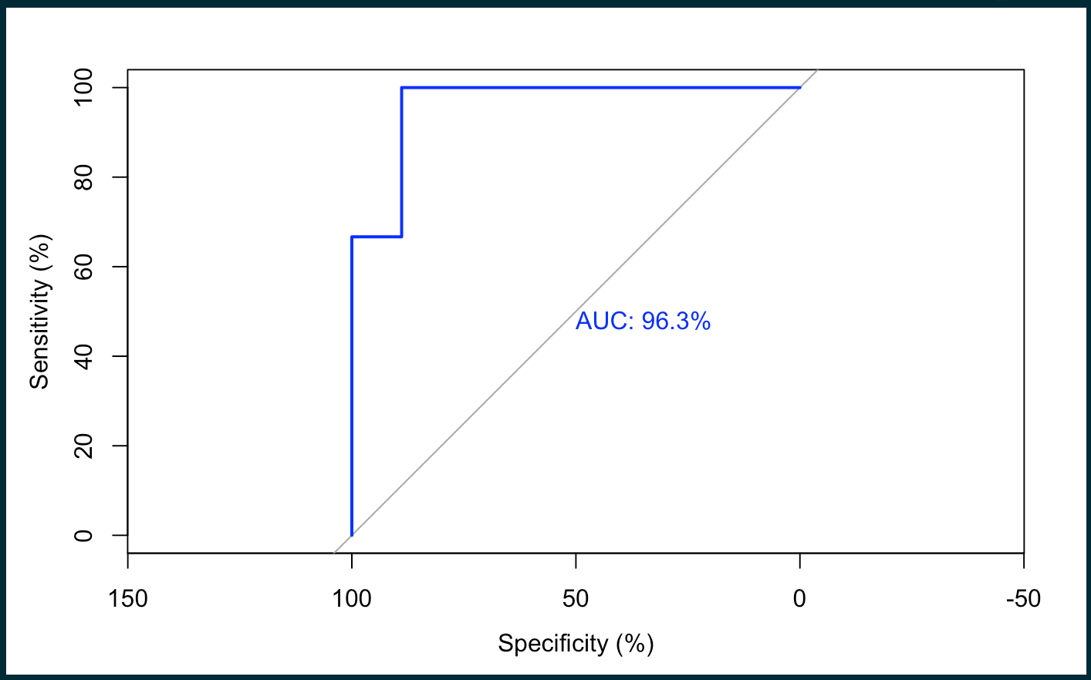
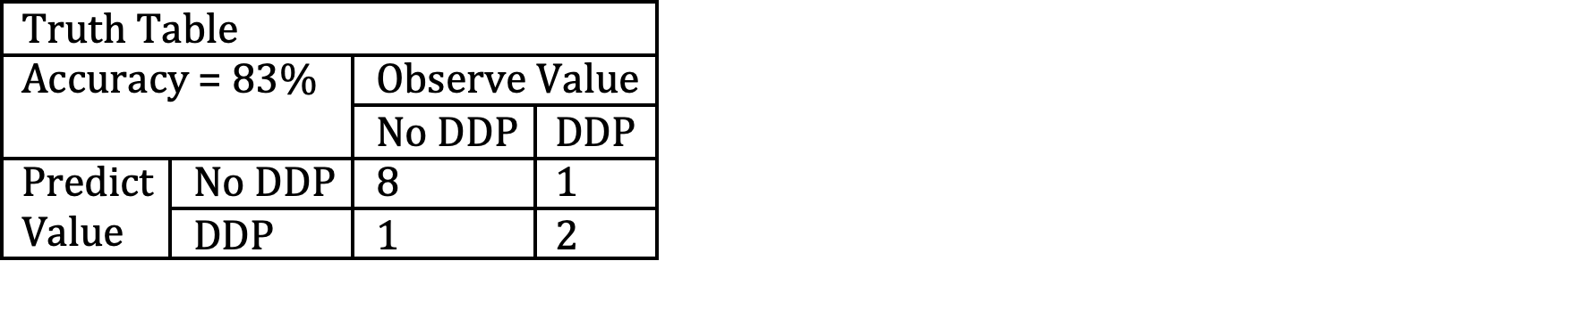
Extension project and insights – Q1
Training data = 32; testing data = 12.
Root-mean square error = 3.21
Area under Receiver operating characteristic curve (ROC) = 96%

Slide 36
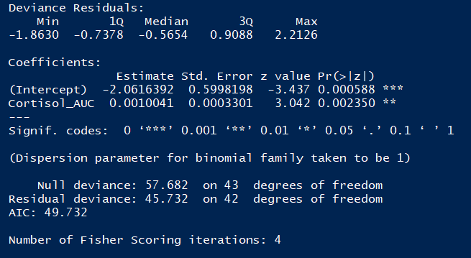
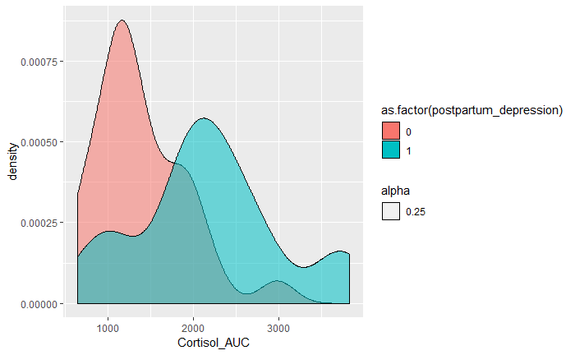
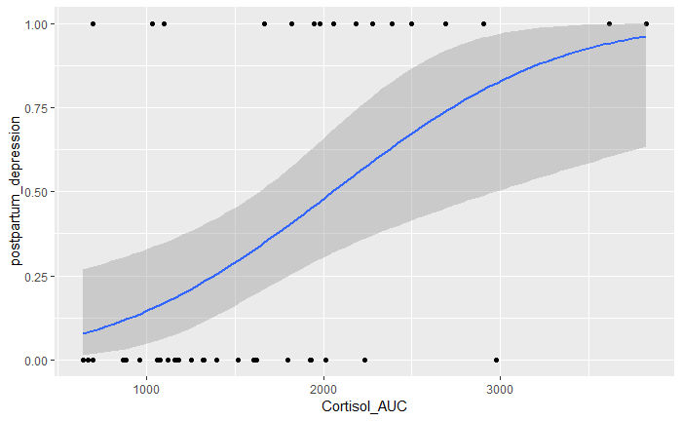
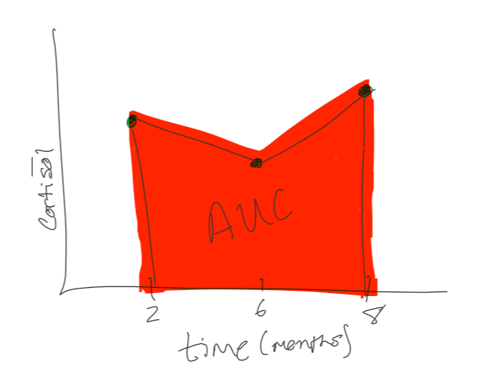
Extension project and insights – Q2
Using the longitudinal cortisol data, we performed linear interpolation to calculate the area under the curve (AUC) for each patient.
Using the cortisol AUC values, we plotted the density distribution, showing clear population divergences
Last, we fit a probit model to our postpartum depression with respect to cortisol AUC values
The ANOVA shows significance

Slide 37
Takeaways
Using hair cortisol and antenatal depression scores can accurate help to predict postpartum depression
How to evaluate performance of a prediction model
How to mitigate the effectiveness of collinearity

Slide 38
Thank you for your listening!
Questions?

